Slide 1
18.404/6.840 Lecture 4
Last time:
- Finite automata → regular expressions
- Proving languages aren’t regular
- Context free grammars
Today: (Sipser §2.2)
- Context free grammars (CFGs) – definition
- Context free languages (CFLs)
- Pushdown automata (PDA)
- Converting CFGs to PDAs
- Problem Set 2 will be posted by tomorrow on the homepage.
- Confirm your checkins are recorded on Canvas/grades.
- The 12:00 and 2pm recitations will be in 2-190, but
have space for 20 people only.

Slide 2








Context Free Grammars (CFGs)
$$G_{1}$$
S $→$ 0S1
S $→$ R
R $→$ $ε$
Shorthand:
S $→$ 0S1 | R
R $→$ $ε$
Recall that a CFG has terminals, variables, and rules.
Grammars generate strings
Write down start variable
Replace any variable according to a rule
Repeat until only terminals remain
Result is the generated string
$L(G)$ is the language of all generated strings
We call $L(G)$ a Context Free Language.
Example of $G_{1}$ generating a string
Tree of
substitutions
“parse tree”
S
0S1
0S1
R
$$ε$$
S
0S1
00S11
00R11
0011
Resulting
string
$$∈L\left(G_{1}\right)$$
$$L\left(G_{1}\right)=\left\{0^{k}1^{k}\right| k≥0\}$$

Slide 3



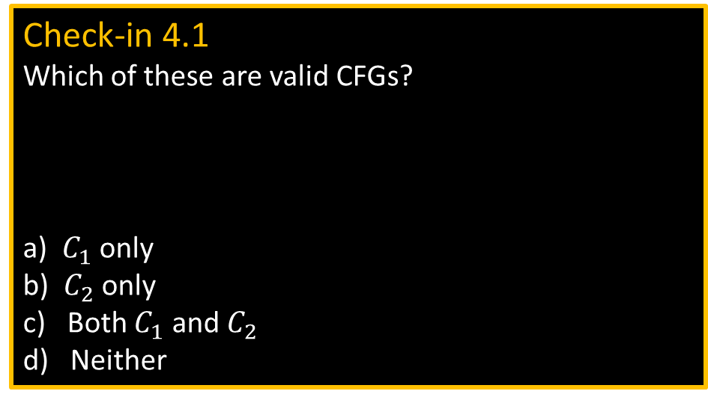




CFG – Formal Definition
Defn: A Context Free Grammar (CFG) $G$ is a 4-tuple $(V,Σ, R,S)$
$V$ finite set of variables
$Σ$ finite set of terminal symbols
$R$ finite set of rules (rule form: $V→{\left(V∪Σ\right)}^{∗}$ )
$S$ start variable
For $u,v∈{\left(V∪Σ\right)}^{∗}$ write
1) $u⇒v$ if can go from $u$ to $v$ with one substitution step in $G$
2) $u⇒v$ if can go from $u$ to $v$ with some number of substitution steps in $G$
$u⇒u_{1}⇒u_{2}⇒⋯⇒u_{k}=v$ is called a derivation of $v$ from $u$.
If $u=S$ then it is a derivation of $v$.
$L\left(G\right)=\left\{w\right| w∈Σ^{∗}$ and $S⇒w\}$
Defn: $A$ is a Context Free Language (CFL) if $A=L(G)$ for some CFG $G$.
Check-in 4.1
Which of these are valid CFGs?
a) $C_{1}$ only
b) $C_{2}$ only
c) Both $C_{1}$ and $C_{2}$
d) Neither
$$∗$$
$C_{1}$:
B $→$ 0B1 | $ε$
B1 $→$ 1B
0B $→$ 0B
$C_{2}$:
S $→$ 0S | S1
R $→$ RR
$$∗$$
Check-in 4.1

Slide 4




CFG – Example
$$G_{2}$$
E $→$ E+T | T
T $→$ T×F | F
F $→$ ( E ) | a
Parse
tree
E
E+T
T T× F
F F a
a a a
E
E+T
T+T×F
F+F×a
a+a×a
Resulting
string
$V=$ {E, T, F}
$Σ=$ {+, ×, (, ), a}
$R=$ the 6 rules above
$S=$ E
$$∈L\left(G_{2}\right)$$
Check-in 4.2
How many reasonable distinct meanings does the following English sentence have?
The boy saw the girl with the mirror.
1
2
3 or more
Generates a+a×a, (a+a)×a, a, a+a+a, etc.
Observe that the parse tree contains additional information,
such as the precedence of × over + .
If a string has two different parse trees then it is derived ambiguously
and we say that the grammar is ambiguous.
Check-in 4.2

Slide 5





Ambiguity
$$G_{2}$$
$$G_{3}$$
E $→$ E+T | T
T $→$ T×F | F
F $→$ ( E ) | a
E $→$ E+E | E×E | ( E ) | a
E
E E
E E
a + a × a
Both $G_{2}$ and $G_{3}$ recognize the same language, i.e., $L\left(G_{2}\right)=L\left(G_{3}\right).$
However $G_{2}$ is an unambiguous CFG and $G_{3}$ is ambiguous.
E E
E E
E

Slide 6

Pushdown Automata (PDA)
“head”
…
a
b
a
b
a
a
Finite
control
input appears on a “tape”
c
Schematic diagram for DFA or NFA
d
(pushdown)
stack
d
Schematic diagram for PDA
Operates like an NFA except can write-add or read-remove symbols
from the top of stack.
push
pop
Example: PDA for $D=\left\{0^{k}1^{k} | k≥0\right\}$
Read 0s from input, push onto stack until read 1.
Read 1s from input, while popping 0s from stack.
Enter accept state if stack is empty. (note: acceptance only at end of input)

Slide 7


Slide 8


PDA – Formal Definition
Defn: A Pushdown Automaton (PDA) is a 6-tuple $(Q, Σ, Γ, δ, q0, F)$
$Σ$ input alphabet
$Γ$ stack alphabet
$δ: Q×Σ_{ε}×Γ_{ε}→𝒫(Q×Γ_{ε})$
$δ\left(q,\text{a},\text{c}\right)=\left\{\left(r_{1},\text{d}\right), \left(r_{2}, \text{e}\right)\right\}$
Accept if some thread is in the accept state at the end of the input string.
Example: PDA for $B=\{ww^{ℛ}|$ $w∈{\left\{0,1\right\}}^{∗} \}$
Read and push input symbols.
Nondeterministically either repeat or go to (2).
Read input symbols and pop stack symbols, compare.
If ever $≠$ then thread rejects.
Enter accept state if stack is empty. (do in “software”)
Sample input:
0
1
1
1
1
0
The nondeterministic forks replicate the stack.
This language requires nondeterminism.
Our PDA model is nondeterministic.

Slide 9
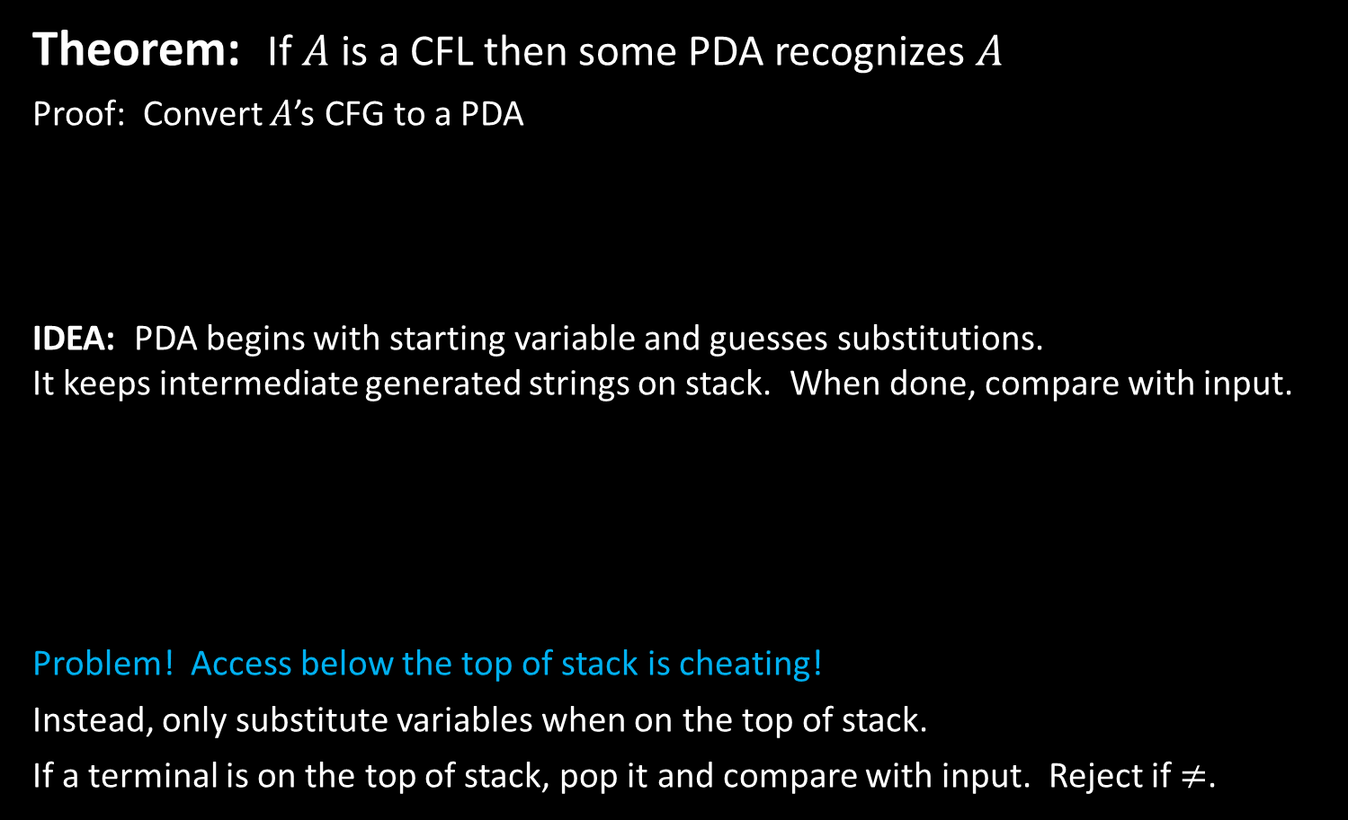



Converting CFGs to PDAs
Theorem: If $A$ is a CFL then some PDA recognizes $A$
Proof: Convert $A$’s CFG to a PDA
IDEA: PDA begins with starting variable and guesses substitutions.
It keeps intermediate generated strings on stack. When done, compare with input.
Problem! Access below the top of stack is cheating!
Instead, only substitute variables when on the top of stack.
If a terminal is on the top of stack, pop it and compare with input. Reject if $≠$.
E $→$ E+T | T
T $→$ …
F $→$ …
PDA
…
CFG
$$G_{2}$$
E $→$ E+T | T
T $→$ T×F | F
F $→$ ( E ) | a
E
E
T
T
+
+
+
Input:
a
+
a
×
a
T
T
T
E
E+T
T+T×F
F+F×a
a+a×a
E
E+T
T T× F
F F a
a a a
×
F

Slide 10
Converting CFGs to PDAs (contd)
$$G_{2}$$
E $→$ E+T | T
T $→$ T×F | F
F $→$ ( E ) | a
Theorem: If $A$ is a CFL then some PDA recognizes $A$
Proof construction: Convert the CFG for $A$ to the following PDA.
Push the start symbol on the stack.
If the top of stack is
  Variable: replace with right hand side of rule (nondet choice).
  Terminal: pop it and match with next input symbol.
If the stack is empty, accept.
Example:
E
E+T
T+T×F
F+F×a
a+a×a
E
E+T
T T× F
F F a
a a a
a
+
a
×
a
E
E
F
T
a
+
T
T
+
+
+
+
T
×
T
T
T
T
F

Slide 11

Equivalence of CFGs and PDAs
Theorem: $A$ is a CFL iff* some PDA recognizes $A$
Done.
In book. You are responsible for knowing
it is true, but not for knowing the proof.
* “iff” = “if an only if” means the implication goes both ways.
So we need to prove both directions: forward ($→$) and reverse ($←$).
Check-in 4.3
Is every Regular Language also
a Context Free Language?
Yes
No
Not sure
Check-in 4.3

Slide 12
Recap
 | Recognizer | Generator
Regular language | DFA or NFA | Regular expression
Context Free language | PDA | Context Free Grammar
Context Free languages
Regular languages

Slide 13
Quick review of today
Defined Context Free Grammars (CFGs)
and Context Free Languages (CFLs)
Defined Pushdown Automata(PDAs)
Gave conversion of CFGs to PDAs.

